Slide 1

College of Education
FY 2024 Planning and Budget Meeting

Slide 2
College / Division Names
Academic Departments
  Counselor Education
  Educational Leadership
  Library Science & Technology
  School of Teaching & Learning
Centers
  Steele Center for Professional Practice (Educator Preparation Services)
  Garrett Center for Transition Services
  Center for Assessment, Research, and Education Safety (CARES)
  Center for International Education
  Center for Research & Clinical Training in Trauma

Slide 3
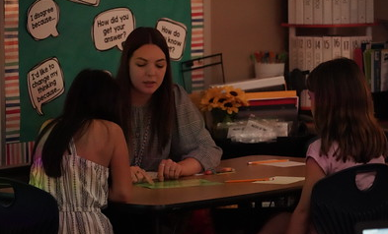
FY 2023 Accomplishments
Priority 1: Prioritize Student Success and Student Access
  Received $1.6M Hawkins Grant (inaugural class) for student success
  Strategic Staffing models across 17 districts
  144 students in paid residency positions
  40 new finalists for Charles Butt Scholars program
  UG degrees in Education Studies, Learning Technologies
  Piloted year-long residency in secondary teaching program

Slide 4
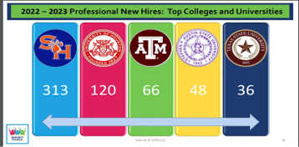
FY 2023 Accomplishments
Priority 2: Embody a Culture of Excellence
  National accreditation renewal from CAEP
  TEA accreditation renewal
  Converted EdD in Literacy to a more comprehensive EdD in Curriculum & Instruction with multiple opportunities for high need specializations
  Converted EdD in Developmental Education Administration into a specialization strand within the EdD in Higher Education Leadership
  Received $200,000 from Powell
  Foundation to launch SHAPE program
  with Huntsville ISD
  Launched COE Research Center, with more
  than 111 students served to date

Slide 5
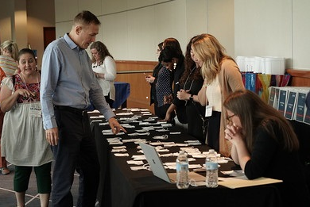
FY 2023 Accomplishments
Priority 3: Elevate the Reputation and Visibility of SHSU
  Applied and accepted to membership in the Council of Academic Deans from Research Education Institutions (CADREI)
  Received $342,300 from the Temple Foundation to expand our EdAide program into northeast Texas and rural service areas
  Selected to host the US PREP Learning Tour as a national showcase for our Year-long Residency model
  SHSU Charter School successes
  CARES successes

Slide 6
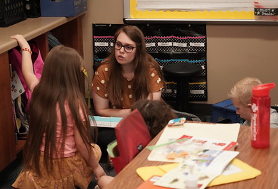
FY 2023 Accomplishments
Priority 4: Expand and Elevate our Service to the State and Beyond
  Developed high quality Alternative Education Certification (ACP) to help meet extensive state-wide teacher shortage
  Received $1.5M from the Houston Endowment to support ACP and early career mentoring in Houston, Spring, and Aldine ISDs
  Selected for TEA grant to pilot statewide Effective Educator Preparation framework
  Developed statewide model for teacher performance-based assessment and provided extensive invited testimony on the outcomes and scalability of this model
  Counseling Clinics provided 3035 hours of services to 424 clients
  Garrett Center on Transition and Disability Services
  hosts Bearkat Bridge Summer Camp & received
  fifth consecutive year of funding to host TEA network

Slide 7
Budget Request
#1 Budget Priority | Director of Clinics (Counselor Education)
Aligned with Strategic Priority Goal | Strategic Priority 1: Prioritize student success and student access. Goal 1: Recruit, retain, graduate, and empower students to drive sustainable growth.
Amount Requested | $87,821
Frequency of Need | Recurring
Opportunity Statement | Director of Clinics is necessary for oversight of more than 100 students, 200 clients, outreach to 30 community partnerships, and 3000 hours of counseling sessions at two locations each year. This position will provide the opportunity for existing faculty to meet workload requirements, as which faculty are currently required to account for approximately 25 hours a week in workload. Position will directly address accreditation needs to meet training standards.
Risk Statement | Risks include inconsistent management of facilities for hundreds of clients and students, not meeting accreditation standards, not providing high quality student preparation experiences, increased risk of client-issue management, and limits to community partnership opportunities.

Slide 8
Supportive Data for Director of Clinics
35.9% increase in SCHs from Fall 2018- Fall 2022
71.9% increase in student headcount from Fall 2018- Fall 2022

Slide 9
Budget Request
#2 Budget Priority | Coordinator II
Aligned with Strategic Priority Goal | Strategic Priority 1: Prioritize student success and student access. Goal 1: Recruit, retain, graduate, and transform students to succeed to drive sustainable growth.
Amount Requested | $69,021
Frequency of Need | Recurring
Opportunity Statement | The State of Texas is in the midst of a teacher shortage bordering on crisis levels. At the start of the 2022-23 academic year, Houston’s five largest school districts reported combined vacancies of 2,236 unfilled teaching positions. SHSU’s COE is poised to lead the way through the high-quality, research-based mentoring program, in which we have adapted the strongest components of our excellent undergraduate teacher preparation program into a more structured and supportive program for alternative certification.
Risk Statement | The newly launched ACP is in danger of failing to meet student needs for success without added certification support. Position will ensure the human capacity exists to support this new program within the SHSU College of Education.

Slide 10
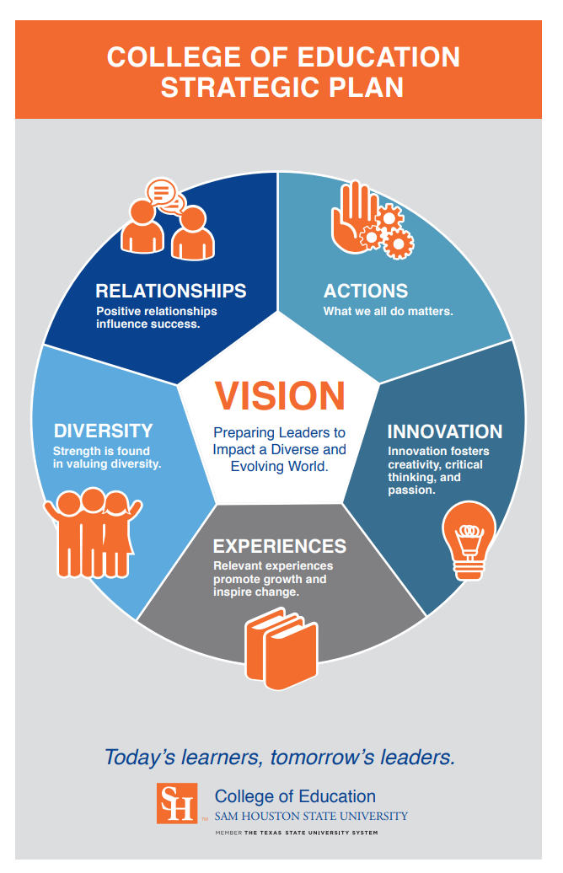
Supportive Data for Coordinator II, ACP
Certificates
600
1,100
Certification Exams
1,800
3,300

Slide 11
Budget Request
#2 Budget Priority
What is the request?
#3 Budget Priority | Specialist II – Educator Preparation Services
Aligned with Strategic Priority Goal | Strategic Priority 1: Prioritize student success and student access. Goal 1: Recruit, retain, graduate, and transform students to succeed to drive sustainable growth.
Amount Requested | $55,542
Frequency of Need | Recurring, One-time
Opportunity Statement | Specialist II staff position to assist with students from the entry to the Educator Preparation Program through graduation. This position will support students in meeting required academic benchmarks and assessments necessary for accreditation and certification. Position will also be essential to providing students with the necessary resources to assist with student success.
Risk Statement | Not supporting this position may result in increased student attrition, higher number of students not completing certification, and lack of direction/support for students in academic need, which may result in a drop in student enrollments and success rates.

Slide 12
Supportive Data for Specialist III (Ed Prep)
15.4% increase in student headcount from Fall 2020- Fall 2022
45.4% (650) of undergraduate students in Fall 2022 were first-generation students

Slide 13
Budget Request
#3 Budget Priority
What is the request?
#4 Budget Priority | Office Furniture
Aligned with Strategic Priority Goal | Strategic Priority 2: Embody a culture of excellence. Goal 3: Provide a supportive, empowering, and culturally responsive workplace.
Amount Requested | $200,000
Frequency of Need | One Time
Opportunity Statement | Faculty and staff office furniture will allow for consistency across-the-board on office furniture setup and will allow for streamlining of capital equipment expenditures at the college level. This request will allow for adequate repurposing of departmental funds to more strategic, student-centered priorities.
Risk Statement | Since this request is HEF eligible, there is an opportunity to fund this request without the need to use designated tuition funds that could be used for more student-centered expenditures. There are multiple non-furnished offices and others that are due for new furniture. The risk of not funding may directly cause redirection of other funds that could be more strategically used.

Slide 14
Summary of Budget Requests
Director of Clinics – $ 87,821
Coordinator II (ACP) – $ 69,021
Specialist II (Ed Prep) – $ 55,542
Furniture – $ 200,000
*Total Amount Requested – $412,384

Slide 15
Self-funded New Initiatives
Performance-based assessment coordinator
Strategic Priorities 1 & 3
  TK20 management platform
      Strategic Priority 2
      Clinical faculty in high need and growing program areas
Strategic Priority 1
  Clinical faculty in ACP
  Clinical lines in Counselor Ed, School of Teaching & Learning
  Post-doctoral position
  Part-time counseling support
      Furniture in TEC
      Strategic Priority 3

Slide 16
Prospective “Big Ideas”
College-wide model for trauma-informed practice
UG degree in addictions services (Counseling) and early childhood services (School of Teaching & Learning)
Innovative, differentiated cost & programming models for competitive masters-level licensure programs
Carnegie Project on the Education Doctorate (CPED)
Secondary Education expansion models
Space utilization redesign of TEC
Strategic Planning and Budgeting

Slide 17
Questions?

